Slide 1
BS IT 5th semester
Lecture 1 & 2

Slide 2
Market
A market is a situation where consumer (buyer) and producer (seller) can gather to facilitate the exchange of goods and services at some price. The market may be physical like a retail outlet, where buyer and seller interact with each other, or virtual like an online market, where there is no direct physical contact between buyers and sellers.

Slide 3
Market equilibrium
Market equilibrium can be defined as a market state where the supply of commodities in the market is equal to the demand of commodities in the market.
In other words it is the interaction of these consumers and producers that will determine the price of the goods and services, therefore, how much consumers will buy and how much sellers will produce.
This point will determine how resources will be allocated efficiently due to the constraints imposed by scarcity.
To examine the solution of market, we must investigate how market works and the significance of market equilibrium.

Slide 4
Continue..
As we studied about the market demand and market supply in chapter 2 and chapter 3.The market demand can be obtained by summing all individual demand of buyers for particular goods in a market. On the other hand market supply can be obtained by summing all the individual seller sells particular goods in a market.

Slide 5
Continue..
Market demand and market supply are the appropriate method for determining the market price.
Equilibrium point is that point in which supplier’s willingness and ability to supply the commodities is exactly equals to its demand which consumer are willing and able to purchase at specific price. The equilibrium in market occurs due to balance of forces. These forces are market demand and market supply.

Slide 6
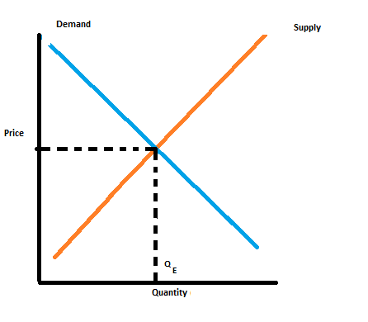
Market equilibrium can be shown using supply and demand diagrams
Market price(Pm) is taken along Y-axis and market quantity i-e Qm (qd and Qs) has been taken along x-axis.
A situation where for a particular good
supply= demand.
When the market is in equilibrium, there is no tendency for prices to change. We say the market-clearing price has been achieved.

Slide 7
Disequilibrium
Unlike market equilibrium, If the market price of goods and services is above or below the equilibrium price, the market is said to be in disequilibrium. Disequilibrium in market occurs when the quantity demand does not equal the quantity supply at particular price.

Slide 8
Conditions of Disequilibrium
There are two conditions of disequilibrium:
Shortage
Surplus.

Slide 9
1. Shortage
A market shortage occurs when there is excess demand of commodity, in other words the quantity demanded by consumer is greater than quantity supplied by producers.
Shortage occurs when prices are below than equilibrium price. This is the situation in market when the consumers are not able to buy as much of a good and services as they would like. In response to consumer’s demand of, producers will increase both the price of their product and the quantity they are willing and able to supply. The rise in price will be too much for some buyer and they will no longer demand the product. Thus increase in quantity of available product will satisfy other consumers. Eventually equilibrium will be attained.
For instance, when the wheat harvest faces loss due to unfavourable weather, and production of bread reduces, thus the demand of consumer remains same as before. Thus the demand exceeds the supply, this is shortage of product in market.

Slide 10
2. Surplus
A Market Surplus occurs when there is excess supply of goods and services, in other words quantity supplied by producer is greater than quantity demanded by consumers.
Surplus occurs when prices are above than equilibrium price. This is situation in market when producers won't be able to sell all their commodities. Thus sellers will decrease the prices of goods and services to make their product more appealing. In response to the reducing price, consumers will increase their quantity demanded for goods, moving the market toward an equilibrium positions (price and quantity). Thus excess supply has exerted downward pressure on the price of the product.
For instance, when the wheat harvest benefits from favourable weather, and the production of bread flour increases whereas consumer continue to buy the same number of loaves of bread as before. Thus the supply of bread is greater than its demand. This is surplus in market

Slide 11
To make it more clear, look at the table;
.
Price per pen | Qd | Qs
5 | 60 | 20
10 | 40 | 40
15 | 20 | 60

